Slide 1


AUTOBOTs
Autonomous Security Engineer

Slide 2

AUTOBOTs
Autonomous Security Engineer
Team Members :
Muhammad Bilal Aslam CYS 2022361
Muhammad Bilal CYS 2022359
Syed Ahmed Haseeb CYS 2022557
Muhammad Hassan Shah CYS 2022385
Supervisor:
Mr. Hafiz Syed Ahmed Qasim
Co-supervisor:
Mr. Muhammad Ahmad Nawaz
Faculty of Computer Science & Engineering (FCSE)
Ghulam Ishaq Khan Institute of Engineering Sciences and Technology, Pakistan

Slide 3
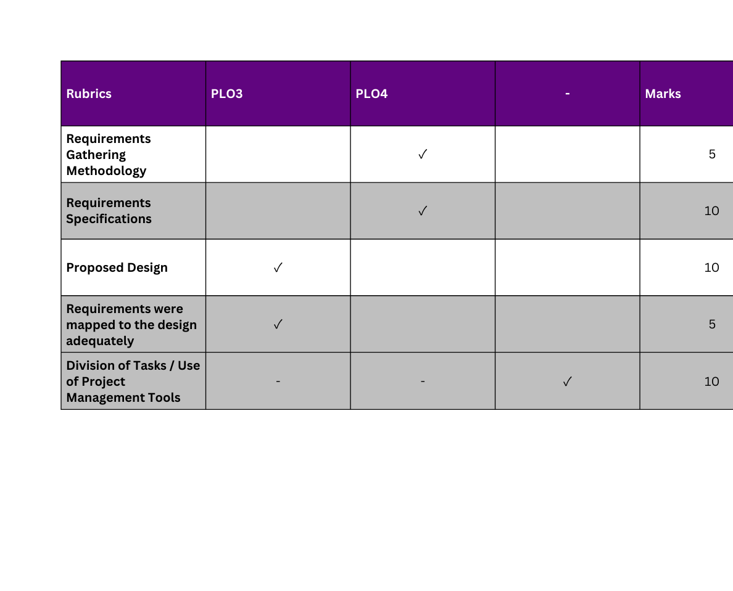
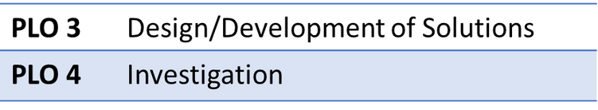
Evaluation Criteria

Slide 4
RECAP
Problem Statement
Recent studies show that 45–66% of AI-generated code (ChatGPT, Copilot, etc.) contains security vulnerabilities, creating serious risks for software integrity.
Hiring Pen-testers is expensive & current AI pentesting solutions are not production-ready:
Promising systems like XBOW and Google Naptime are still in development.
Existing tools lack autonomy, struggle with accuracy, and often fail compliance and security standards.
There is a critical need for a secure, intelligent, multi-agent system that can:
Operate with minimal supervision
Adapt to evolving and complex threats
Perform reliable, end-to-end vulnerability assessment at scale

Slide 5
Introduction
Challenges Faced
Compliance Conflicts:
Security/Ethical Risks:
Computational Demands:
Difficulty aligning with multiple standards (GDPR, PCI-DSS, ISO 27001)
Ensuring the system cannot be misused for harmful activities.
Need for high compute resources to support multi-agent AI.

Slide 6



Requirements Gathering Methodology
Requirement Elicitation & Validation Approach
01. Interviews
Conducted expert interviews with security researchers from
Trillium Information Security System
Askari Bank
Systems Limited
Insights helped validate AUTOBOTs’ features, particularly in
Autonomous testing,
Exploit verification,
Scalable security workflows.
This process ensured that our system aligns with
Industry expectations,
Compliance requirements,
Practical cybersecurity workflows.

Slide 7
Requirements Gathering Methodology
Requirement Elicitation & Validation Approach
02. User Observations
H-1B visa costs are rising to $100k+ per employee, pushing companies away from offshore cybersecurity hiring.
Highly sensitive environments require on-site security, but qualified local talent is scarce, and remote work isn't allowed.
Enterprises now adopt autonomous security bots to balance cost, security, and scalability.
These bots deliver consistent, high-quality monitoring and incident response at a fraction of human-only team costs.

Slide 8
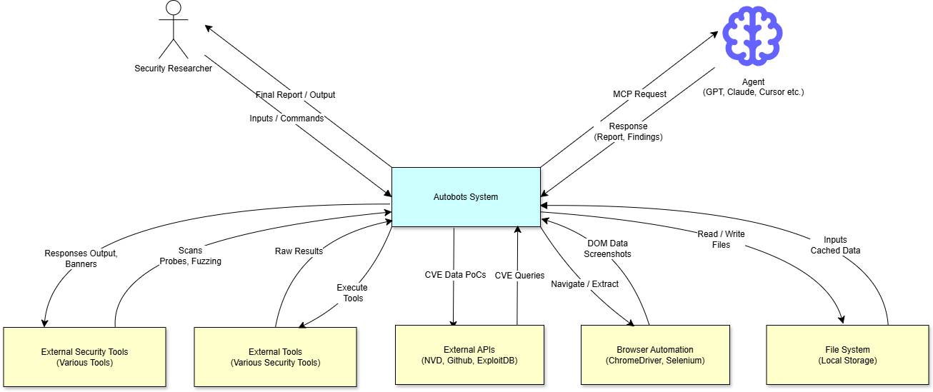
Requirements Specifications
Context Diagram

Slide 9
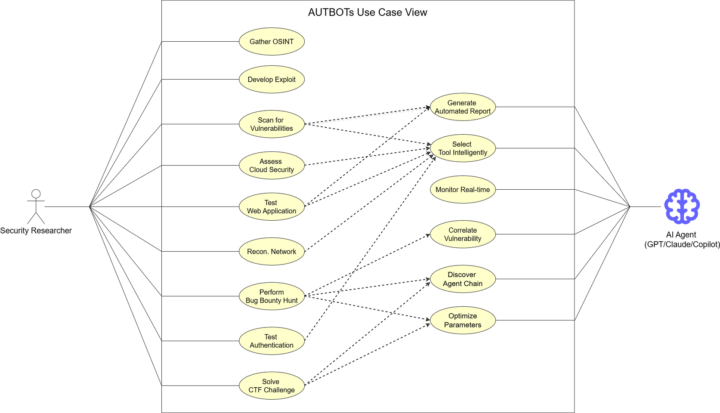
Requirements Specifications
Use Case View

Slide 10
Requirements Specifications
Feature Set Matrix
Features / Use Case | Priority of Development | Dependencies
AI agent Connection | Essential, High | Network Infrastructure, API endpoints, authentication keys
Intelligent Analysis | Essential, High | LLM API, training datasets, compute resources
Automonous Execution | Essential, High | AI agents, integrated cybersecurity tools, permissioned targets
Real-Time Adaption | Essential, Medium | AI inference engine, continuous feedback loop
Advanced Reporting | Essential, Medium | Reporting engine (PDF/DOCX/HTML generators)
Privacy & Data Security | Essential, High | Encryption libraries, authentication modules, secure communication protocols

Slide 11
Distinguishing Functional Requirements
#01. AI Agent Connection
#02. Intelligent Analysis
#03. Autonomous Execution
#04. Real-time Adaptation
#05. Privacy & Data Security
#06. Advanced Reporting

Slide 12
Distinguishing Non-Functional Requirements
#01. Reliability & Usability
#02. Maintainability
#03. Scalability
#04. Robustness
#05. Testability

Slide 13
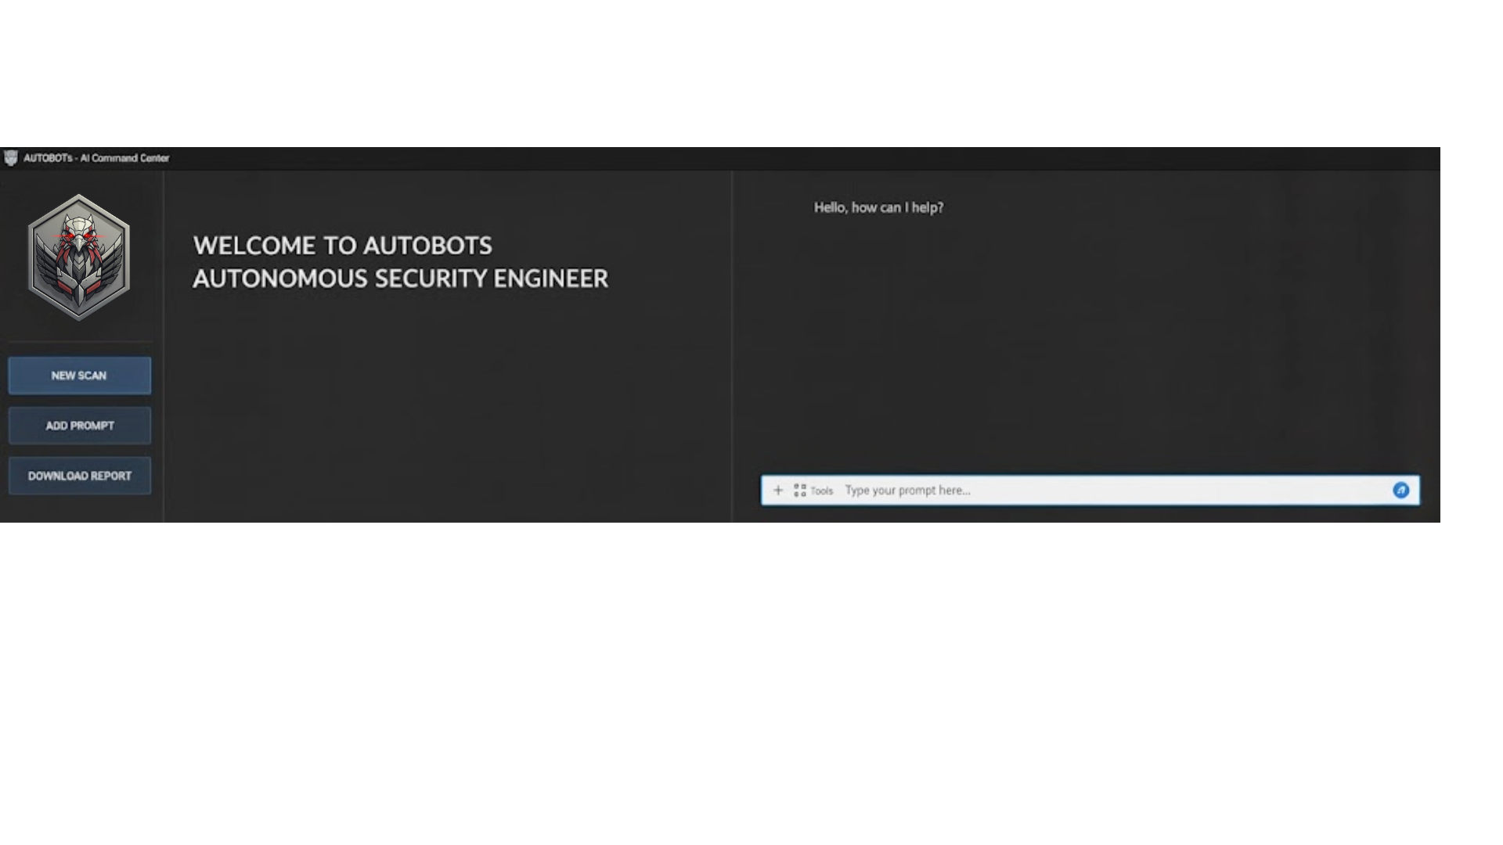
User Interface Requirements
Local Application User Interface of AUTOBOTs

Slide 14

User Interface Requirements
Along with our Own Design, with AUTOBOTs, we aim to introduce seamless integration in security researcher’s day-to-day solutions
e.g. Cross-platform desktop AI assistants like 5IRE

Slide 15
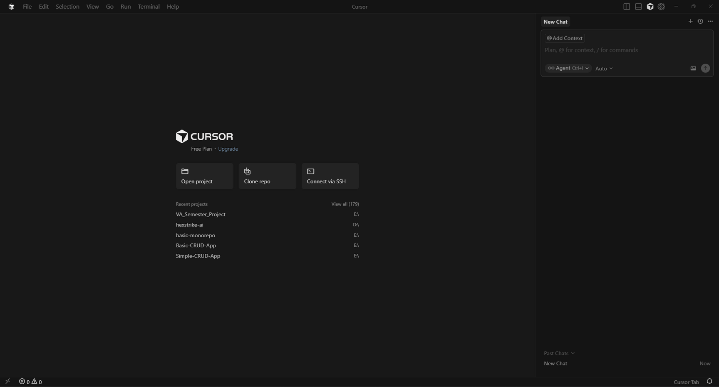
User Interface Requirements
Seamless integration with
solutions like IDE’s e.g. Cursor

Slide 16
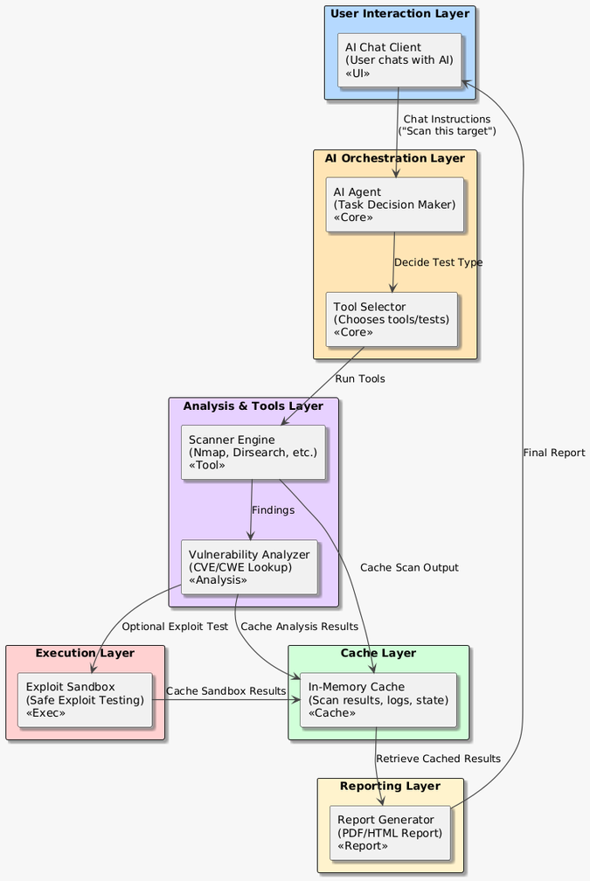
System Architecture
System Architecture
Visual blueprint that shows components structure & realtionship within the system.

Slide 17
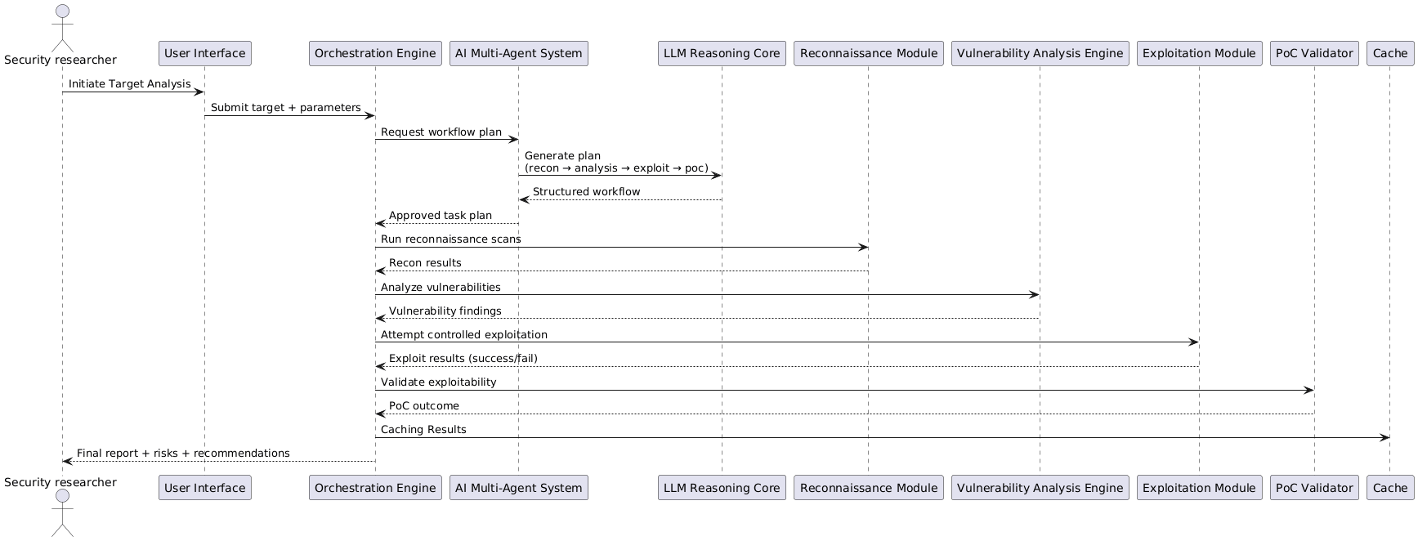
UML Diagrams
Sequence Diagram
Sequence of Messages exchanged between objects in a system to complete a specific task or use case.

Slide 18
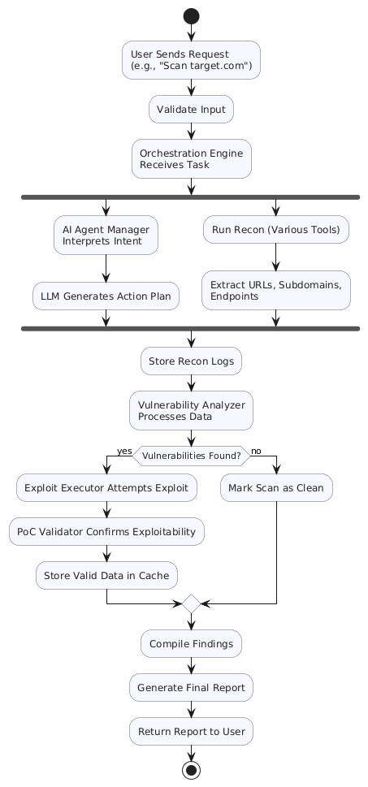
UML Diagrams
Activity Diagram
Models the flow of control & data between
different activities in the system

Slide 19
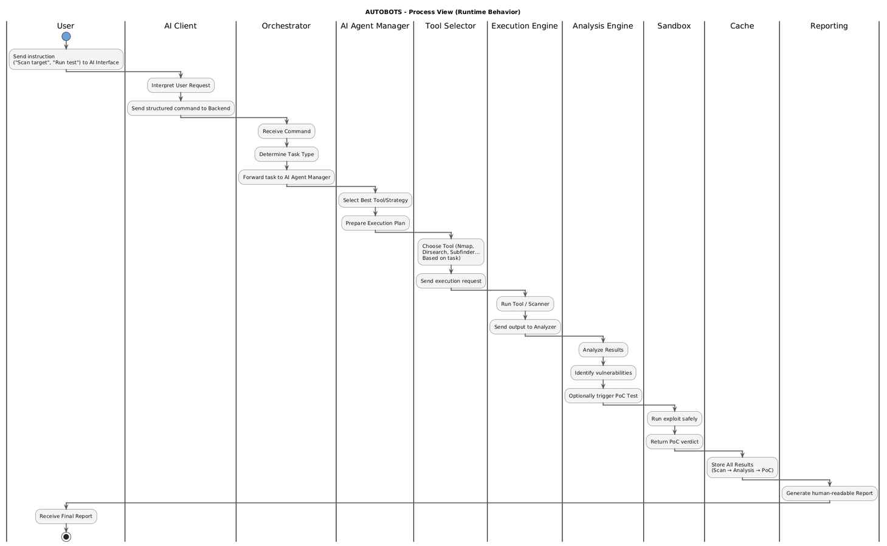
UML Diagrams
State Transition Diagram
Visual representation that shows a systems possible states & events or inputs that caused it to transition between those states

Slide 20
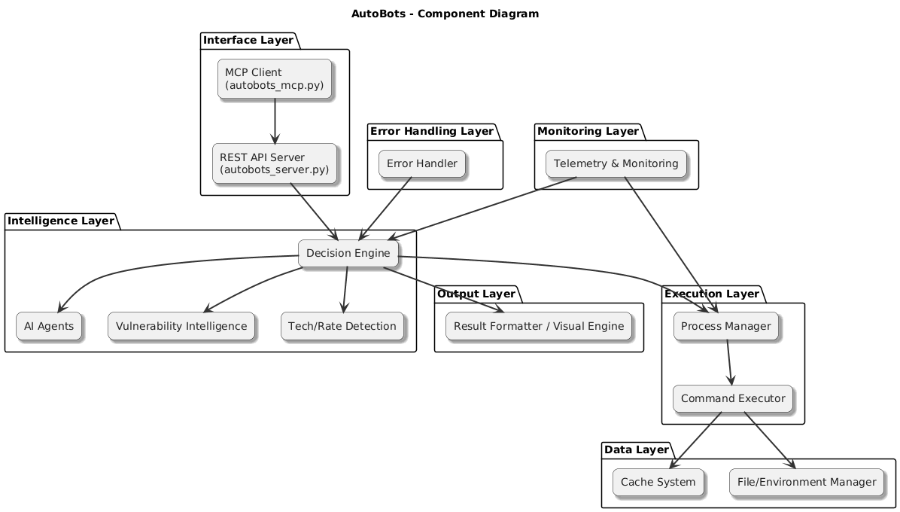
UML Diagrams
Component Diagram
Visualizes the internal structure of the system.

Slide 21
UML Diagrams
ER Diagram
We do not use any traditional database for AUTOBOTs.
All data is stored in a file system storage temporarily in an in-memory cache for a single session only.
This approach helps us maintain a strong security posture by ensuring no long-term data persistence.
Once the session ends, all cached data is automatically cleared, minimizing the attack surface and eliminating risks associated with data leakage or unauthorized access.

Slide 22
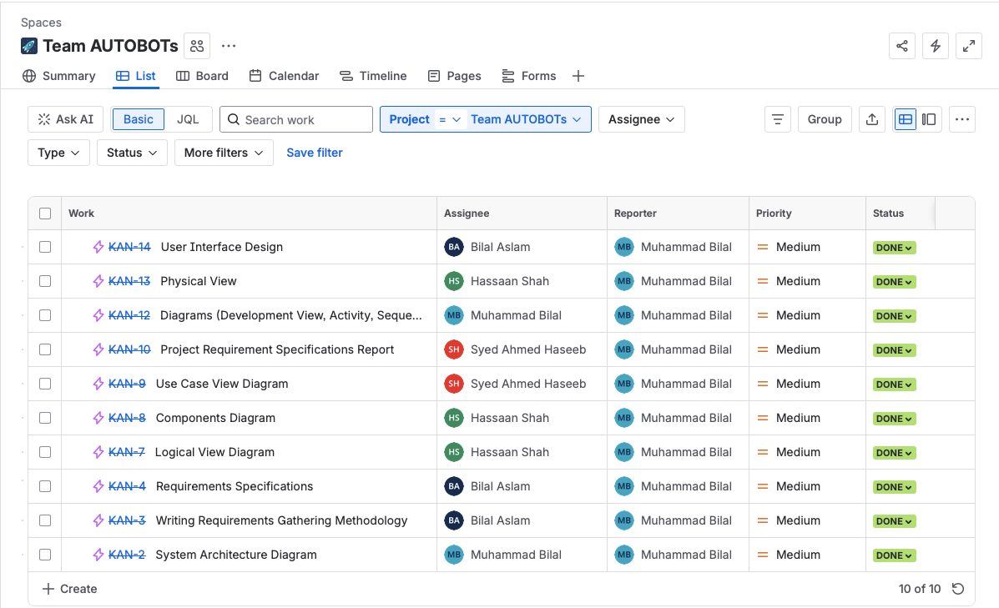
Project Management
Project Management Tool
We Used Jira & Clickup for Project Management.

Slide 23
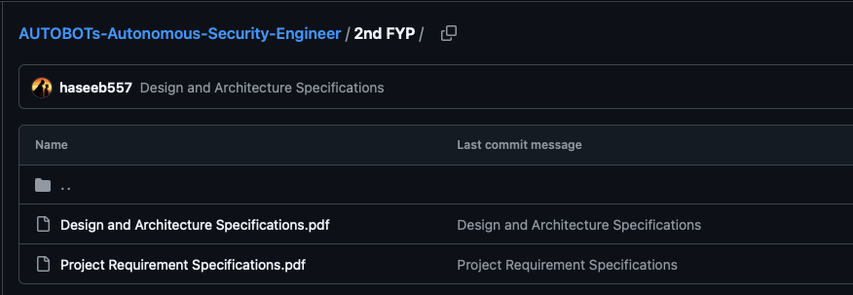
Project Repository
GitHub Repository

Slide 24
Division Of Tasks
System Architecture
Development View
Activity Diagram
Sequence Diagram
User Observations
Context Diagram
User Interface Design
M. Bilal
M.Bilal Aslam
User Interface Design
Context Diagram
State-transition Diagram
Components Diagram
Logical view
Physical View
Requirement Specifications
Interviews
Use Case Diagram
Hassaan Shah
Syed Ahmed Haseeb

Slide 25
Q&A

Slide 26
Thank You
Team Project AUTOBOTs

